Slide 1


DEEP LEARNING FOR SATELLITE IMAGE
Presented By Zhiting (Fiona) Zhang

Slide 2

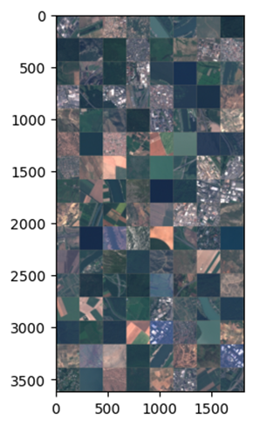
DESCRIPTION
This project was about image classifications on low-resolution satellite images. It aimed to challenge a common real-world problem: extracting valuable features and insights from images that lack details and have special orientations. It held importance in the field of urban planning, environmental monitoring and agriculture.

Slide 3

DATA PRE-PROCESSING
SPLITTING
AUGMENTATION
NORMALIZATION
Test: 30% of the original
Training to Validation: 70:30
Random Resizing and Cropping
Random Horizontal Flip
All images in the dataset were standardized in a consistent way.

Slide 4
MODEL ARCHITECTURE
BLOCK STRUCTURE
REGULARIZATION
3 convolutional blocks
1 convolutional layer + 1 max pooling layer for each blocks
ReLU for activation
Batch Normalization
Dropout

Slide 5

MODEL TRAINING
SETTINGS
Learning rate = 0.01
Optimizer = SGD
Number of epochs = 25
Early stopping with validation loss
RESULTS
CNN model: best validation accuracy of 78.85%; best validation loss of 0.6524
ResNet18 model (transfer learning): best validation accuracy of 97.57%; best validation loss of 0.0751

Slide 6
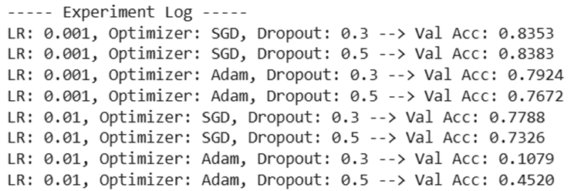
HYPERPARAMETER TUNING
Learning Rate
[0.001, 0.01]
Optimizer
SGD or Adam
Dropout
[0.3, 0.5]

Slide 7

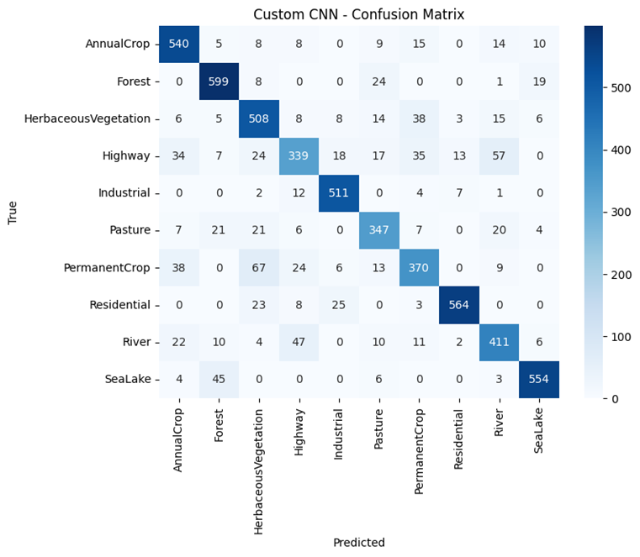
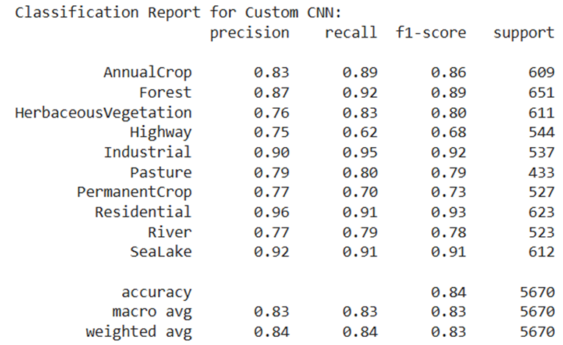
EVALUATION - CNN
Validation Accuracy of 83.65%

Slide 8
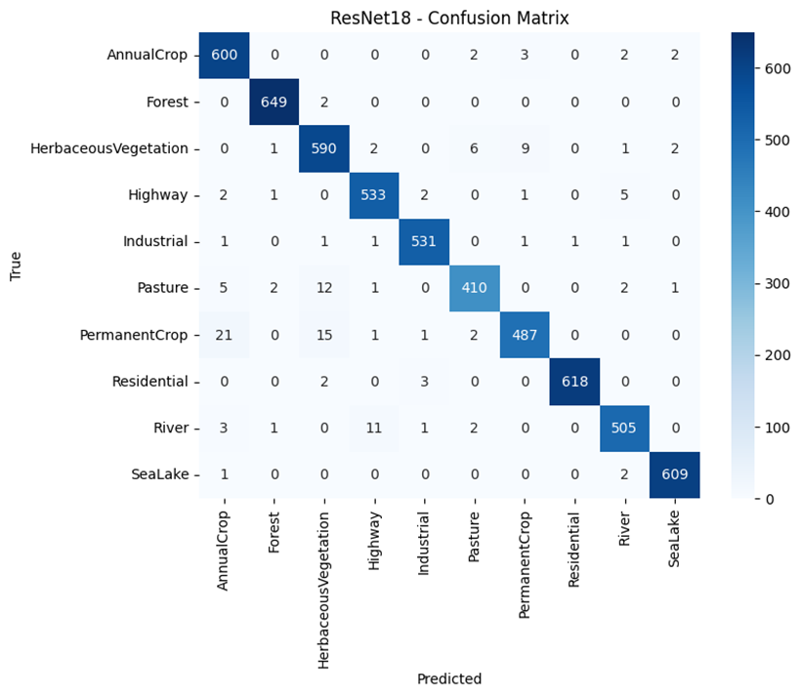
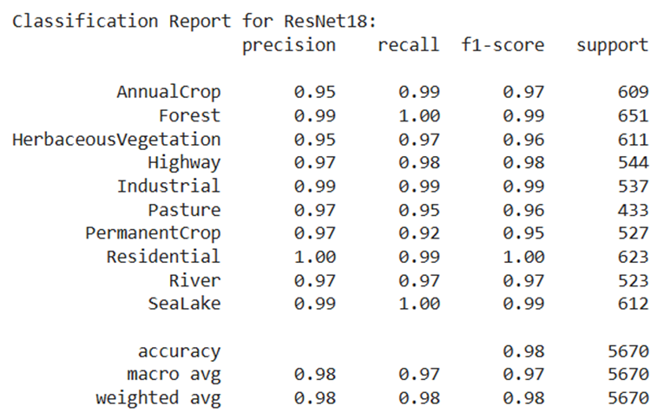
EVALUATION - RESNET18
Validation Accuracy of 97.57%

Slide 9
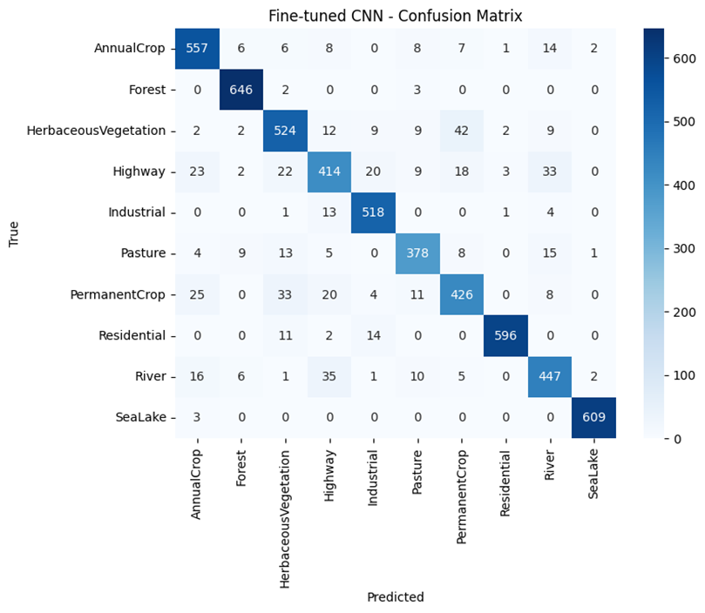
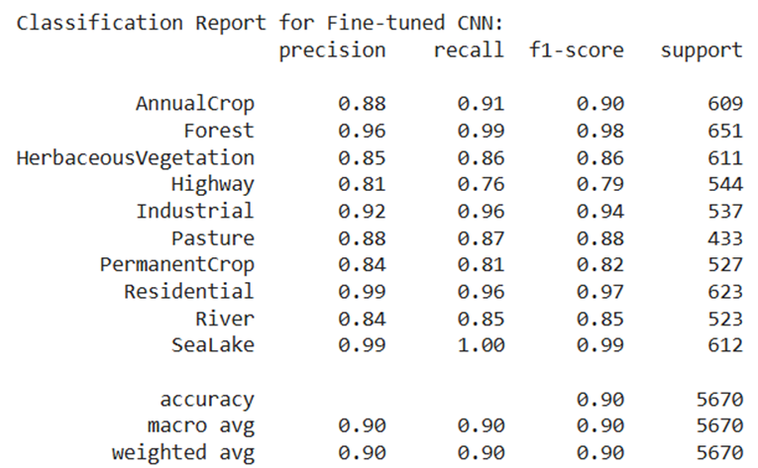
FINE-TUNING - EVALUATION
More convolutional blocks and more convolutional layers
Validation Accuracy of 90.21%

Slide 10
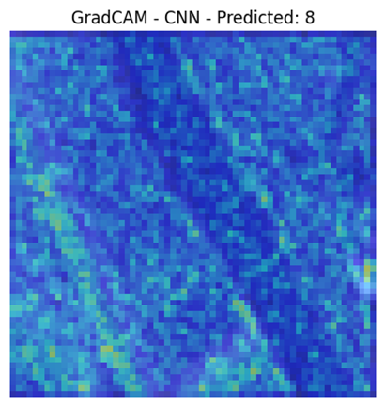
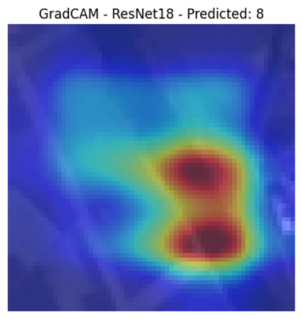
GRADCAM VISUALIZATIONS
FINE-TUNED CNN
RESNET18

Slide 11

TESTING & CONCLUSION
The fine-tuned CNN model was tested on the held-out test dataset and achieved a test accuracy of 89.95%. Since the number was close to its validation accuracy, no signs of overfitting or underfitting was observed.
The ResNet18 model was tested on the held-out test dataset and achieved a test accuracy of 97.16%. Since the number was close to its validation accuracy, no signs of overfitting or underfitting was observed.
Overall, after several steps of tuning, the CNN model was performing very well on the chosen dataset, yet it was not able to beat the pre-trained ResNet18 model which was doing too well on classifying the satellite images, proving that models pre-trained on large, high-quality dataset would help compensate the lack of details of the low-resolution images.
For actionable future improvements, we could either keep tuning the CNN model by building more complex architectures and searching over wider ranges of hyperparameters, or fine tune the ResNet18 model a little bit to make it work even better. Furthermore, we could test some totally different neural network architectures, such as autoencoders, on the dataset.

Slide 12
THANK YOU

